Slide 1

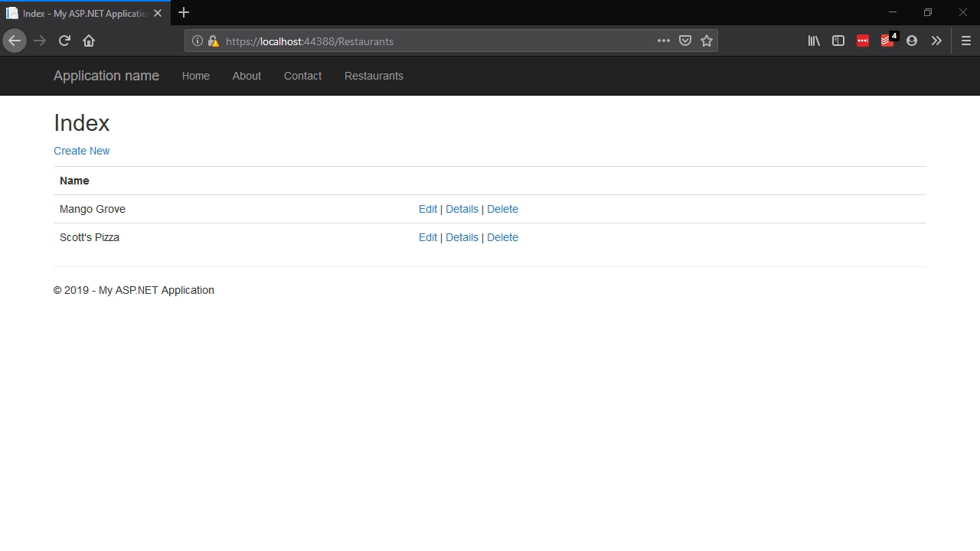
ASP.NET Core 3
Building Apps & Services - Whats New!?
K. Scott Allen
@OdeToCode

Slide 2
ASP.NET Core 3 Building Apps & Services - Whats New!?
K. Scott Allen
@OdeToCode

Slide 3






.NET Core
Fast
Cross-platform
Lightweight
Open Source
Compatible
Tools

